Slide 1
Strategy of Self-driving based on Cellular Automata and Game Theory
Team members: 贾斐然 杨俊 张雯

Slide 2
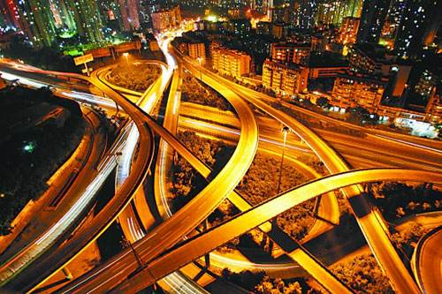
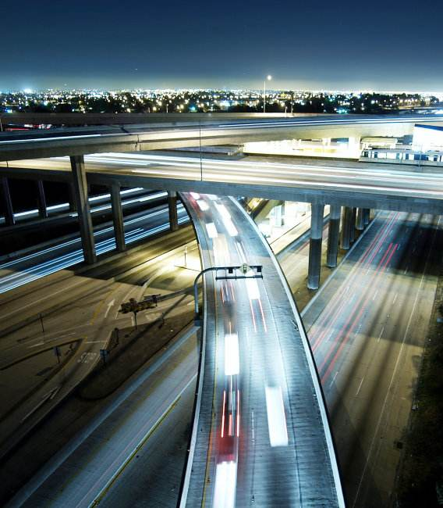
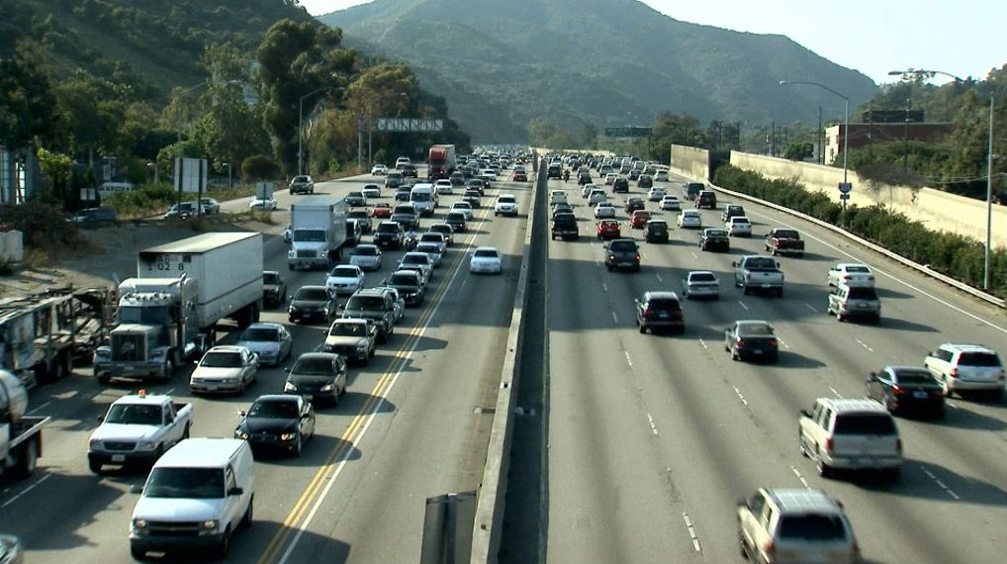
Background
Notes:
two kinds of self-driving cars, one is cooperative cars which are expected by the government, the other is non-cooperating cars which use a variety of techniques to detect their surroundings then do some responses.

Slide 3
Issues
The strategy of two kinds of self-driving cars.
Route planning for two kinds of self-driving cars.
The properties of the strategies.
The effects change as the percentage of self-driving cars increase.

Slide 4
Driving model
Driving strategy: Si = {Ah, Ch}
Velocity: Vi ={0,1,2}
Some basic rules of CA model according to velocity and safety velocity.
Notes:
1. The car with Vm = 2 can move forward 1 cell next time, which means decelerate this unit time.
2. The car with V1 = 1 can move forward 2 cell next time if and only if there is no car on the forward two cells, which means the car accelerate.
3. There is a stochastic deceleration probability which shows the mistake if justice.
4. When the distance between the car and the forward car is shorter than safe distance, the car cannot accelerate nor change its lane because of the consideration of safety.
5. The car cannot change its lane if the safety distance is not satisfied.

Slide 5
Vehicle model
For non-cooperative cars: Greedy Principle
For cooperative self-driving car: Cooperation first
Notes:
Decision making style

Slide 6
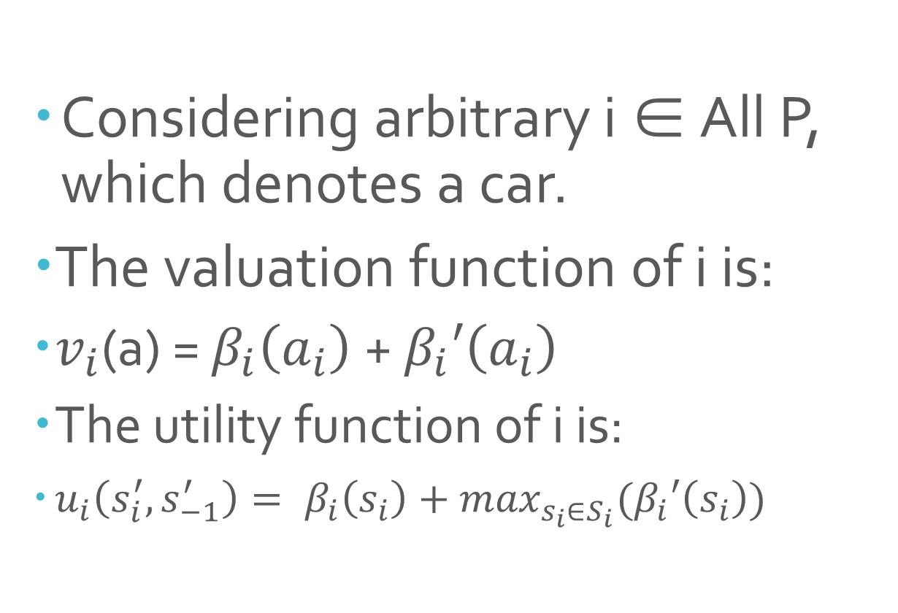
Greedy Principle
Considering arbitrary i ∈ All P, which denotes a car.
The valuation function of i is:
$v_{i}$(a) = $β_{i}\left(a_{i}\right)$+ $β_{i}′\left(a_{i}\right)$
The utility function of i is:
$u_{i}\left(s_{i}^{′},s_{−1}^{′}\right)= β_{i}\left(s_{i}\right)+\max_{s_{i}∈S_{i}}(β_{i}′\left(s_{i}\right))$
Notes:
Drivers (cars) always want to reach the destination in the shortest time but they cannot get the full information of traffic situation. They choose the current optimal choice, which means that they use greedy strategy and they aim to do best response in each game.

Slide 7
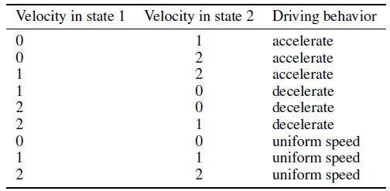
The conditions of driving ahead

Slide 8
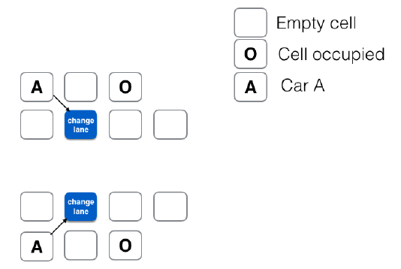
The conditions of changing the lanes

Slide 9
Cooperation strategy
Suppose three cars 1, 2 and 3 which are all cooperative self-driving cars have collisions, the decision space of them is S1 , S2 and S3 are the collections of all decisions of 1,2 and 3 respectively. The strategy of 3 in allocation is:
Notes:
s1 ∈ S1 is the decision of 1, s2 ∈ S2 is the decision of 2 and s3 ∈ S3 is the decision of 3.

Slide 10
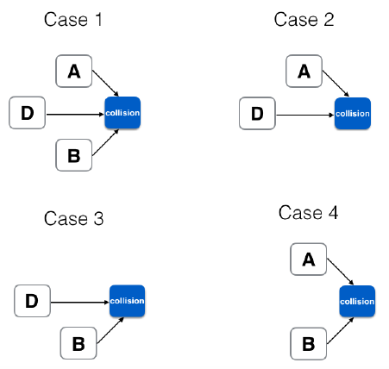
The collision conditions

Slide 11
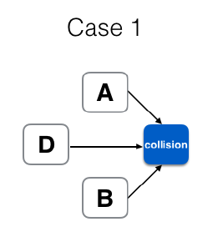
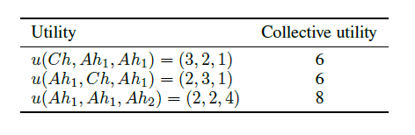
Analysis of case 1

Slide 12
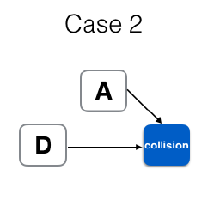
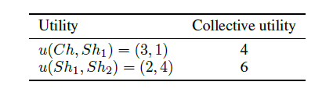
Analysis of case 2

Slide 13
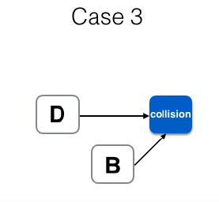
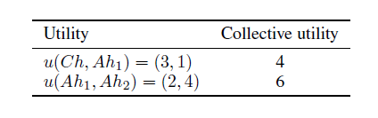
Analysis of case 3

Slide 14
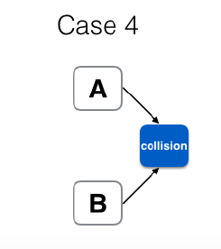
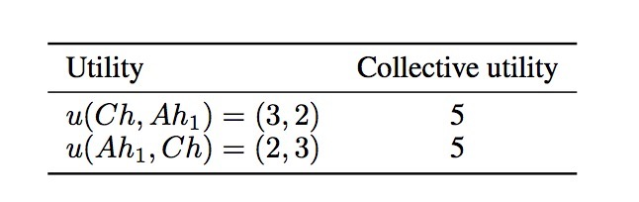
Analysis of case 4

Slide 15


Properties for non-cooperative Mechanism
Truthfulness:
Individual Rationality:
Efficiency:

Slide 16
Properties for cooperative Mechanism
Truthfulness:
Individual Rationality:
Efficiency:

Slide 17
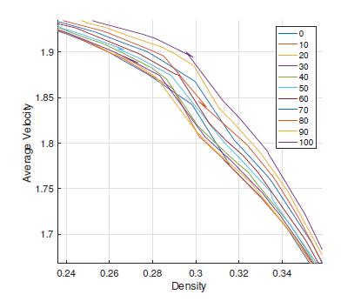
Model result

Slide 18
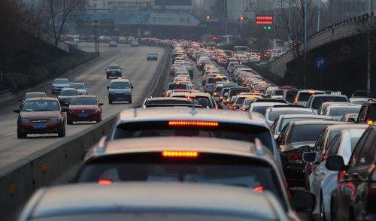
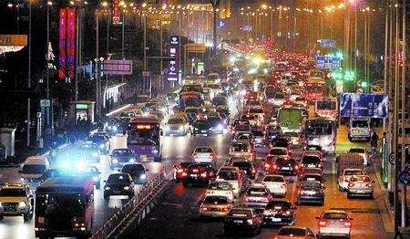
Traffic jams

Slide 19
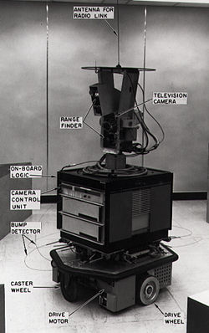
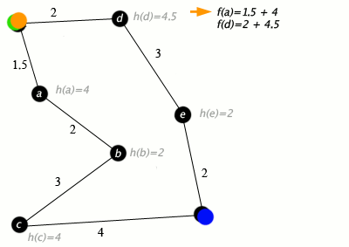
About A* search algorithm
Notes:
人工智能学科的创立者之一，斯坦福大学的教授尼尔森，试图提高他的机器人shakey的行走效率，因为一旦障碍物增加（老是撞墙），传统的用来计算最短路径的迪杰斯特拉算法的运行速度已经远远落后，一种具有启发式的路径规划算法被提出那就是是A1算法，拉斐尔 和 哈特 先后完善和证明了A1算法，形成了A*算法。

Slide 20

About A* search algorithm
10
5
11.2

Slide 21
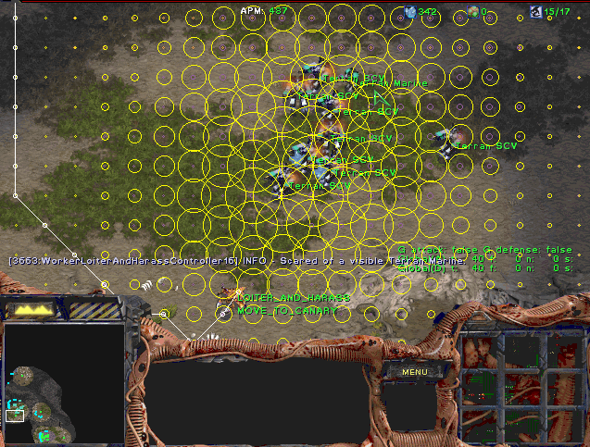

About A* search algorithm

Slide 22
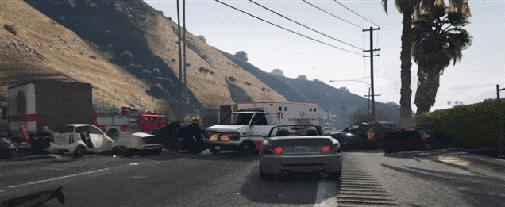

Routing planning strategies for Non-cooperative self-driving cars
In A ∗, the function should be f (n ) = g (n ) + h (n )
8
e
h=1
1
1
3
2
S
a
d
G
h=6
1
h=5
h=2
h=0
1
c
b
h=7
h=6
Notes:
We select the points which minimize f (n ) in order to find the shortest route. g (n ) is the cumulative distance between the start point and current point, h (n ) is the distance between current point and terminal point.

Slide 23
Properties for non-cooperative Mechanism
Truthfulness:
Efficiency:

Slide 24
Routing planning strategies for cooperative self-driving cars
In the cooperation mode, we can obtain the road condition of city by Central Management System.
f (n ) = g (n ) + h (n ) + p (n )
8
+ 1
e
h=1
1
+ 4
+ 3
+ 2
+ 5
1
3
+ 1
2
+ 4
S
a
d
G
h=6
1
h=5
h=2
h=0
1
c
b
h=7
h=6
Notes:
We also use the A* algorithm and add another term p(n) which means the number of cars.
We finally get f(n)=g(n)+h(n)+p(n). In this case, the route may not the shortest path but the optimal path.

Slide 25
Properties for non-cooperative Mechanism
Truthfulness:
Efficiency:

